Slide 1


Long Term Plan 2022- 2027
IFRS16
September 2022

Slide 2
How to deal with IFRS16 in the LTP?
LTP will present consolidated data post IFRS
IFRS16 entries (Cost of financing, Right of Use and Lease Liability) are directly included in all indicators concerned (amortization, financial costs, CAPEX)
However, in order to facilitate IFRS16 estimation on main KPI (Amortization and CAPEX), here are guidelines on how to deal with current portfolio and new contracts
For current portfolio
you will not receive any automatic extraction for LTP
you will find all the information in Viareport in dedicated reports (slide 3&4&5)
For new contracts,
a dedicated excel sheet is available in LTP input Matrix to support you if necessary in the valuation of the Right of Use and subsequent amortization
you will find all explanations in page 20 of LTP User guide

Slide 3
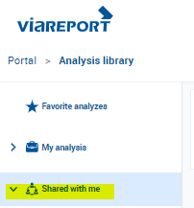
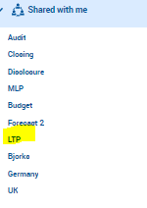

Viareport – Web Analyzer reports dedicated to LTP
2 reports dedicated for LTP 2022

Slide 4
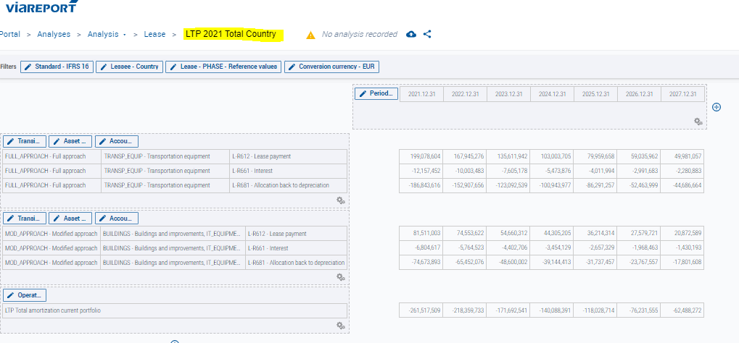
LTP 2022 Total Country
Will provide you with the total amount of amortization for years 2024 to 2028
For the whole country
Change the country and the currency and refresh the report

Slide 5
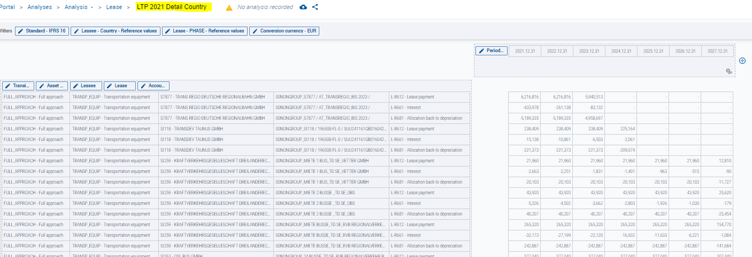
LTP 2022 Detail Country
Will provide you with amounts by contracts for years 2024 to 2028
Allowing you to rework the information to have the amortization at LTP activity level
Change the country and the currency and refresh the report
You have the possibility to export data on excel to filter by contract / activity
If you need help to retrieve fields to have information on the business, feel free to contact Julie MARTINEAU /Marie NICOLLET

